Slide 1
Team for Final Project

Slide 2
Section A: https://docs.google.com/spreadsheets/d/1z3kQ_ilGzpyLeEOBMW_EZ_XVbBIE9I0jOHRVAXJK89c/edit?usp=drive_link
Section B: https://docs.google.com/spreadsheets/d/1NXcgwEEfdqKzRZqZj4GyWLtK75At4JUNtX3XeUH2HFg/edit?usp=drive_link

Slide 3
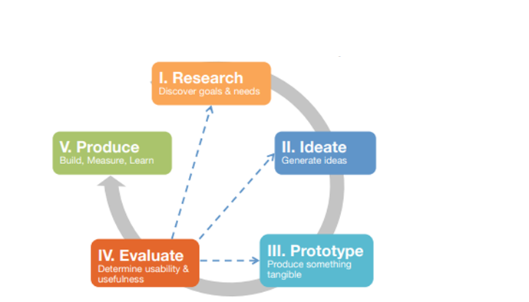
Design process at a glance

Slide 4
Research

Slide 5
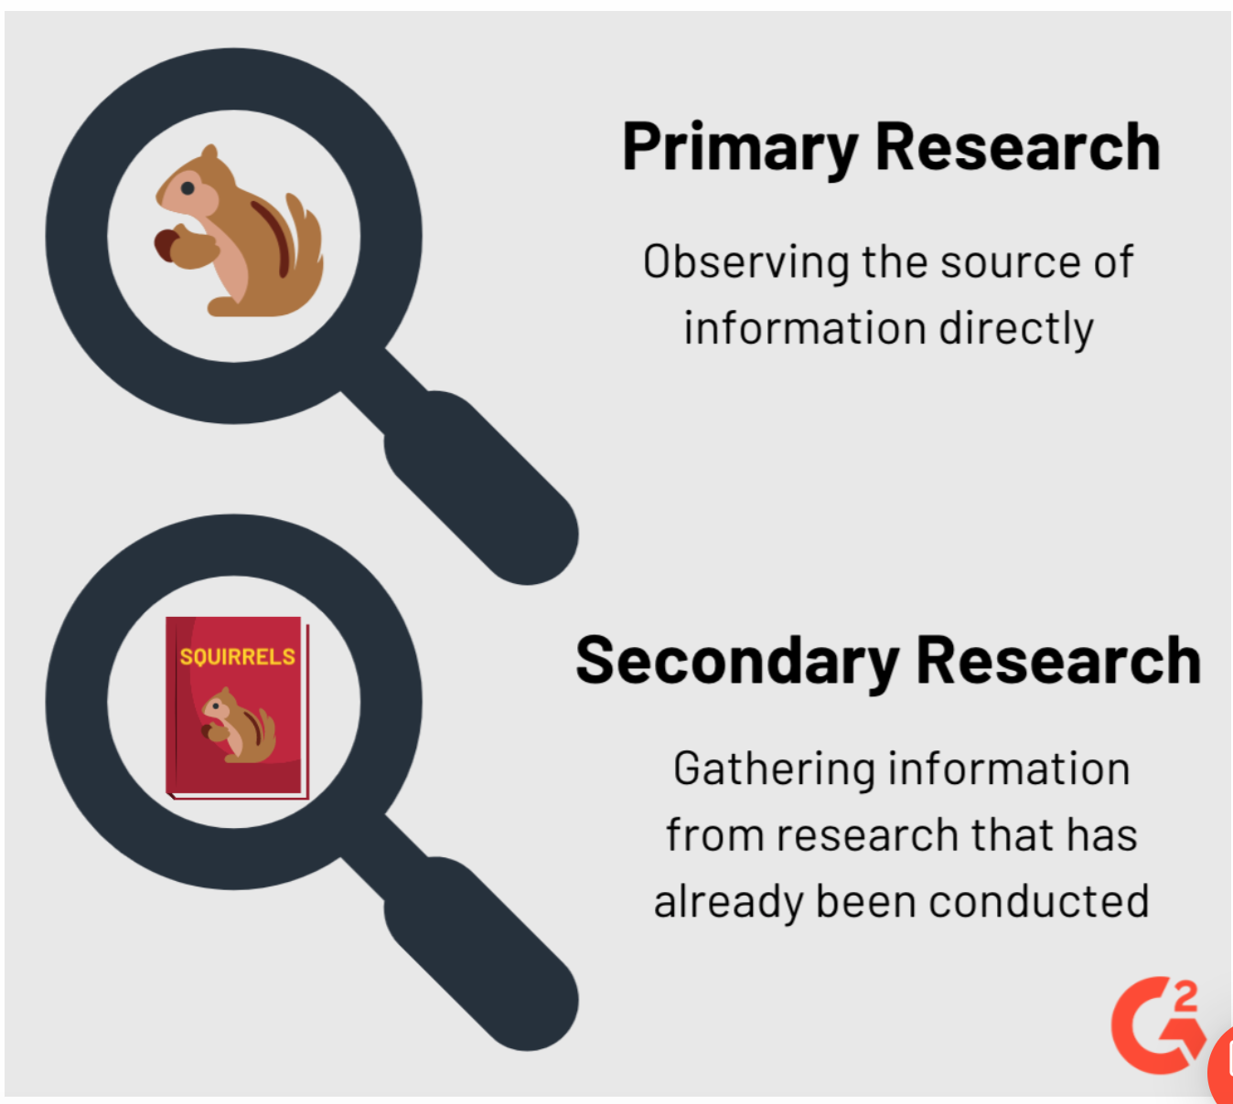
Primary vs Secondary Research

Slide 6
When and why do we conduct secondary research?
When?
Secondary research is easy to do and should be the first step in any systematic investigation.
Why?
Establish what has already been done and what hasn’t and identify knowledge gaps and niches to suggest a research direction, methods, theories and/or potential contributions.
"If I have seen further, it is by standing upon the shoulders of giants”
------ Newton
Note: Every Project starts with Secondary Research.

Slide 7




Secondary Research
Possible sources of secondary research include:
Books, Research papers, Journal articles, Conference papers
Marketing, Consumer and Economic Data
Museums, Archives, Archaeological sites, Satellite Imagery, Large Datasets
Records and statistics from government, non-government organizations (NGOs)
Newspapers, Tech Magazines, TV shows, Youtube, Social Media, etc.

Slide 8
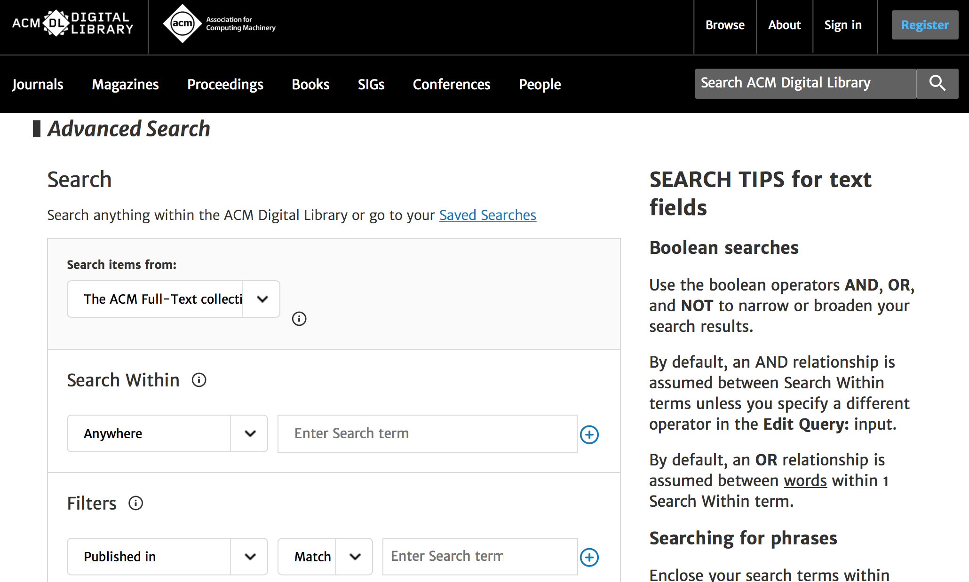
Secondary Research
We can search for these sources on the internet, for example:
ACM digital library
Notes:
Show the ACM Digital Library
https://idp.login.iu.edu/idp/profile/cas/login?execution=e1s2

Slide 9
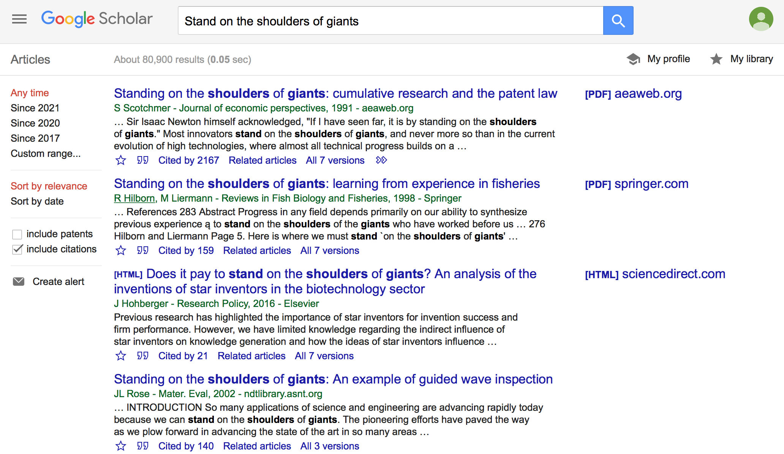
Secondary Research
We can search for these sources on the internet, for example:
Google Scholar
Notes:
https://scholar.google.com/

Slide 10
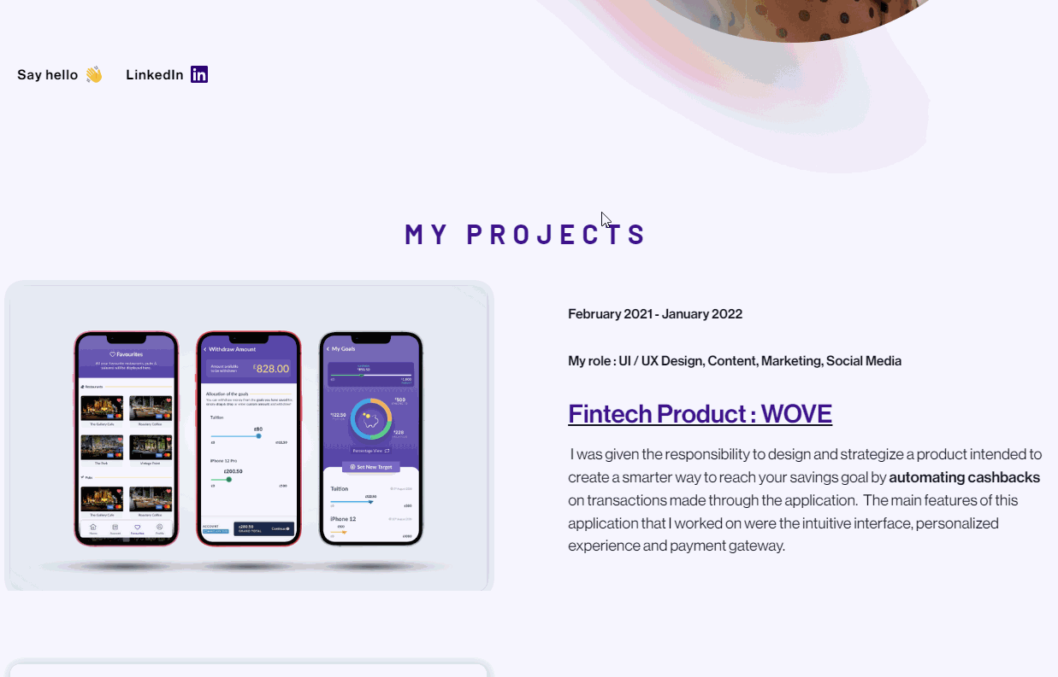
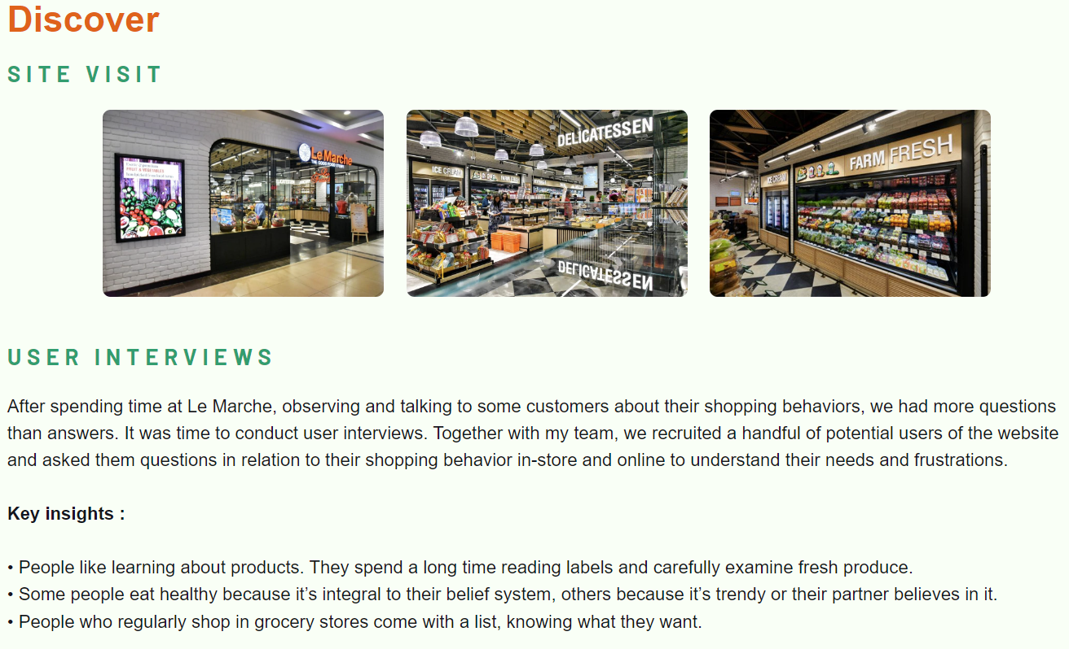
Secondary Research
For designers, possible sources of secondary research may also include:
precedent projects, products or case studies documented in various ways;
photographs, maps, diagrams, and other visual support records;
Portfolio by Maliha Hashmi https://www.malihahashmi.com/

Slide 11

Primary Research: HCI Research Methods
HCI research methods aim to solve problems related to different research tasks such as data gathering, analysis, evaluation, etc.
HCI methods are basically various ways of conducting research on a specific subject, population (human, non-human), problem, etc. (e.g., interviews, surveys, data gathering through diaries, etc.)

Slide 12
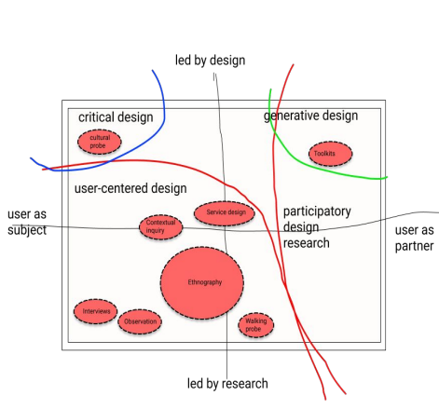
Maps of HCI Methods
The methods could also be organized into 4 genres
Futuring: design fiction, critical design, speculative design, what-if cards,
Co-creative: participatory design, co-design, toolkit, participatory mapping
Ethnography: auto ethnography, video ethnography, photo ethnography, observation, behavioral mapping, interview, contextual inquiry, walking probe
Constructive: sketching, brainstorming, exemplar creation

Slide 13
Observation

Slide 14
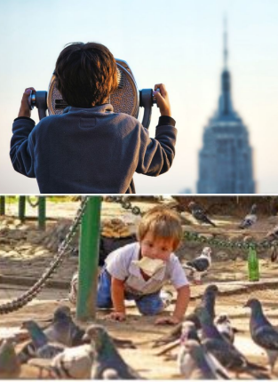
Observation
Observational research (or field research) is a type of correlational (i.e., non-experimental) research in which a researcher observes ongoing behavior

Slide 15
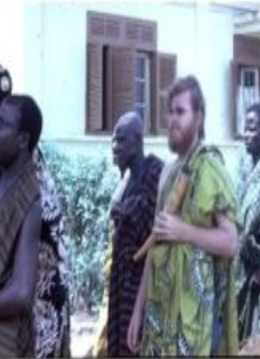
Participant Observation
Involves the researcher observing the participants’ activity by entering the community (place) and by actively taking part into the observed activity.
Researchers use this method to understand a phenomena by experiencing themselves.

Slide 16
Participant Observation
Pros
The researcher have the hands-on experience and be able to get into the meanings, viewpoint, values, and problems of the observed phenomena
Provide provision to develop insights where questioning is ineffective
Cons
Being actively part of the activity researcher may develop empathy towards the observant, which may result in bias.
May give rise to several ethical concerns.
It is time consuming.

Slide 17
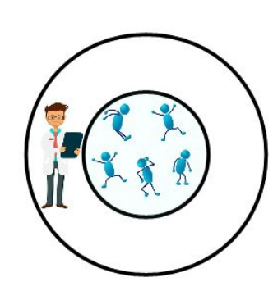
Non-Participant Observation
Involves the researcher observing the participants’ activity by entering the community (place), however, being completely separate from the observed activity
Researchers use this method to understand a phenomenon by viewing what is going on with their own eyes

Slide 18
Non-Participant Observation
Pros
Allows the researchers to be more open minded, as they are not being sympathetically involved into the observed phenomena.
Allows researcher to make judgement and observe body language.
Cons
As researchers are not actively taking part into the observed phenomena, hence, there is a chance that the researchers may end up not getting accurate data for observing from the distance.
It is time consuming.
People may change behavior if they are informed being observed

Slide 19
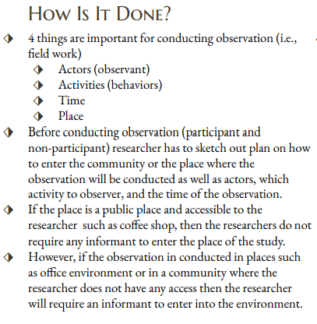
How to conduct observation?

Slide 20
Field notes by researchers, photos, drawings, etc.
The collected data from the observation will allow the research to have the clear picture of the behavior, body language, used terminology, used tools of the observant.
Besides, the data will allow to explore the interaction of different actors with other actors, tools, and environment.
When researcher actively take part into activity during observation, he/she can get into the observants’ meanings, viewpoints, values, and problems.
What data is produced?

Slide 21
Behavioral Mapping

Slide 22

Behavioral Mapping
An observational techniques that tracks behavior over place and time
Produces graphical representation of behavior over place and time

Slide 23
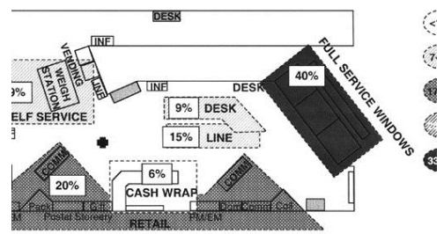
Behavioral Mapping: Examples

Slide 24
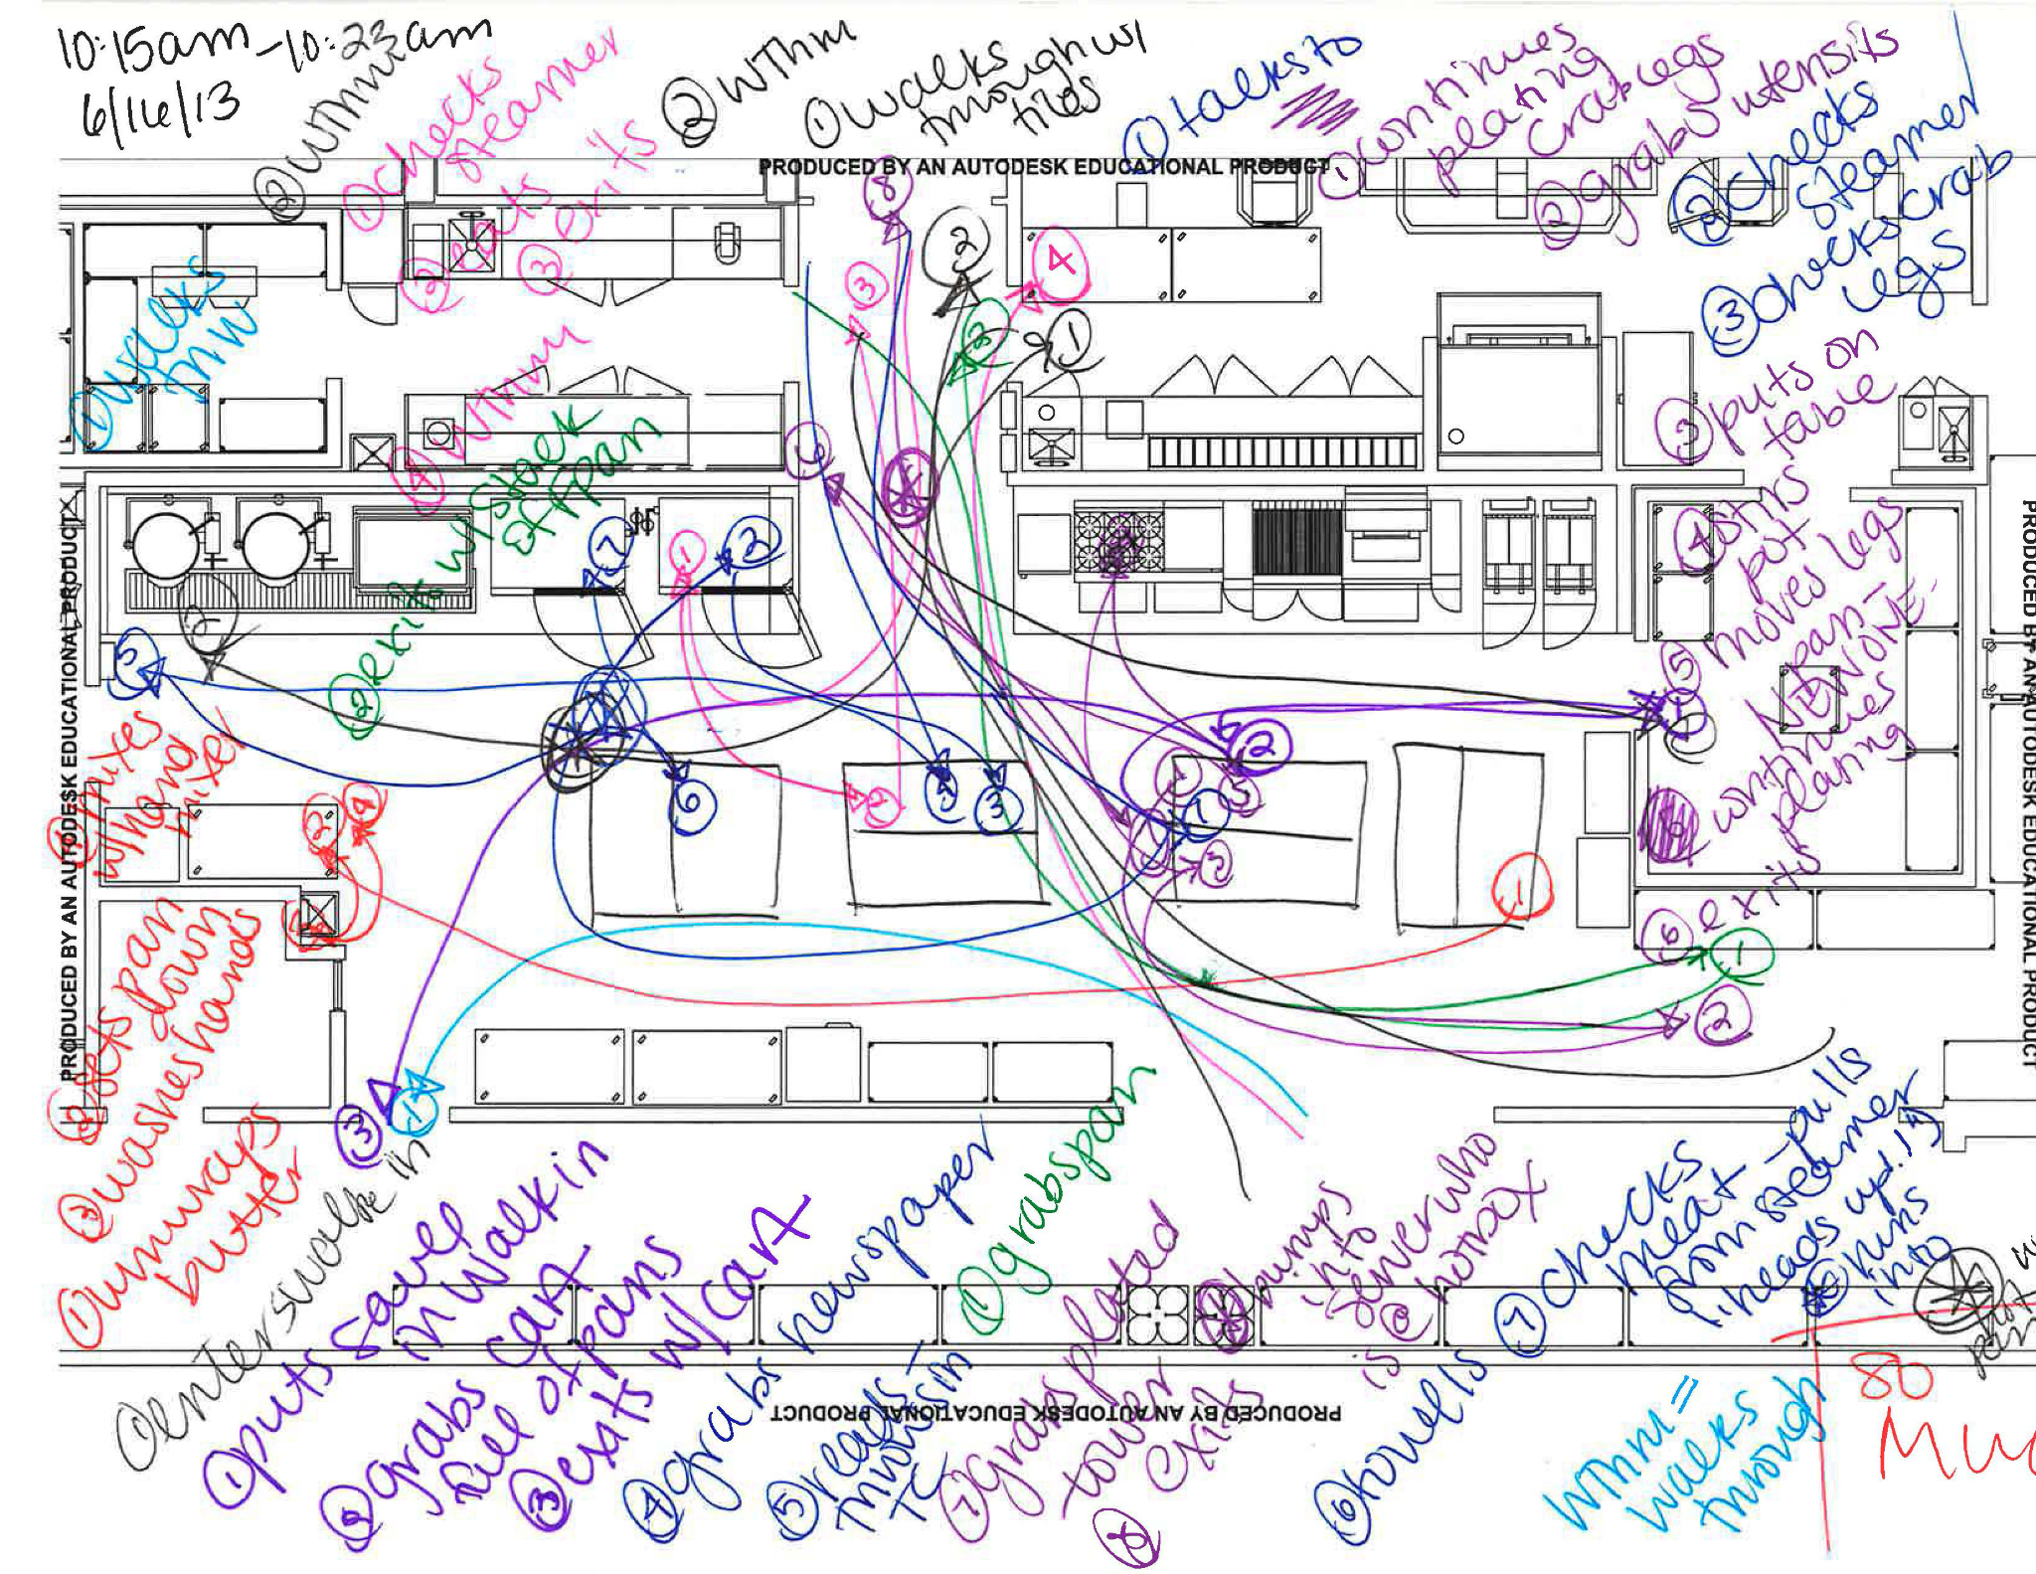
Behavioral Mapping: Examples

Slide 25
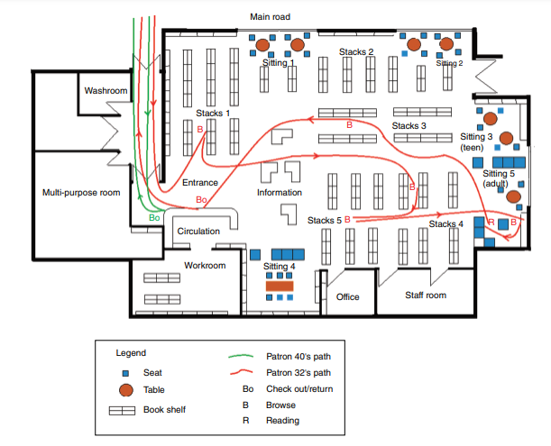
Behavioral Mapping: Examples

Slide 26

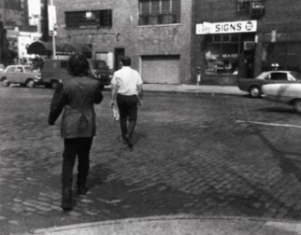
Behavioral Mapping
Place-centered
document the behavior of all the individual within a specified space and time
the researcher is situated at one place
example: plotting location of people in a store/play area
People-centered
document the behavior of an individual over space and time
the researcher is mobile, shadowing an individual
example : following an older adults to learn about his social interaction

Slide 27
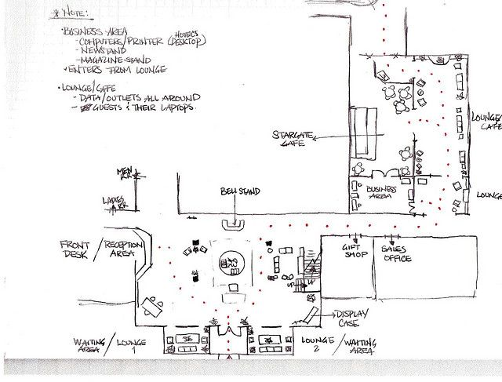
How is it done?
A detail planning is required for conducting behavioral mapping, the researchers have to start with an area plan (having multiple copy would be preferable)
Next, the researchers has to decide on a list behaviors to be recorded and methods on recording those behaviors
Go to the site location and conduct observation and map the observed behavior on the site map annotated with time
Aggregate all the observed behavior on the map to illustrate pattern
Generated data: Graphical representation of the behavior, photos, video, field notes
In summary, things to consider
Actors
Activities: interactions, actions, practice, process
Space: environment, settings
Time: how action unfolds over time
Artifacts: props, tools

Slide 28
Behavioral Mapping
Pros
suitable to explore the usage of a place and understanding how people conduct activity within a place
delineate the patterns of movement and use across places
cost-effective.
Cons
very time consuming
require more human resources

Slide 29
In-class Activity

Slide 30
In-class activity (15 mins)
Based on the video
Create a behavioral map that is either place-centered or individual-centered
Things to consider
Actors
Activities: interactions, actions, practice, process
Space: environment, settings
Time: how action unfolds over time
Artifacts: props, tools
Video link: https://www.youtube.com/watch?v=AhbCYVILusc (Clip identified and prepared by Yuhao Shi)

Slide 31
Homework

Slide 32
Identify Problem space
As a group identify a problem space
Can explore conferences, i.e., CHI proceedings for inspiration
Write a problem statement
Upload the problem statement on Miro board
Section A
https://miro.com/app/board/uXjVNfrrTzk=/?share_link_id=427275997515
Section B
https://miro.com/app/board/uXjVNfpWi4s=/?share_link_id=59174979440

Slide 33
Formulate Problem Statement
Who is affected?
Who is experiencing the problem? Can this user be further specified (by demographic, persona, motivation, reason for being in the situation)?
What is the problem?
What are the struggles? What task needs to be accomplished? What pain point needs to be relieved?
Where does it happen?
What is the context in which the user experiences the problem? Is it in a physical or digital space? Who else is involved?
Why does it matter?
Why is this problem worth solving? What value does it bring to the user? What value does it bring to the business?

Slide 34
Formulate Problem Statement
Our (who) has the problem that (what) when (where). Our solution should deliver (why).
Example: “Our new mum has the problem that she has no one to talk to about the best way to care for her baby when she is at home alone every day. Our solution should deliver a way for her to feel connected to other mums so she feels less isolated and alone.”

Slide 35
Links

Slide 36
Drive link
https://drive.google.com/drive/folders/1biCaA15muh4bgCpA2NVoGytVpbXqIQ_J?usp=drive_link

